Slide 1
Preparing for an IPv6 World with LXI Instruments

Slide 2
IPv6 is Coming…
IPv4 Addresses Running Out
“Montevideo, 3 February 2011—The Number Resource Organization (NRO) announced today that the free pool of available IPv4 addresses is now fully depleted”
Internet Community Gets Serious about IPv6
6 June, 2012—World IPv6 Launch brings permanent IPv6 support by major web sites, internet service providers, and network infrastructure
No significant problems occurred.

Slide 3
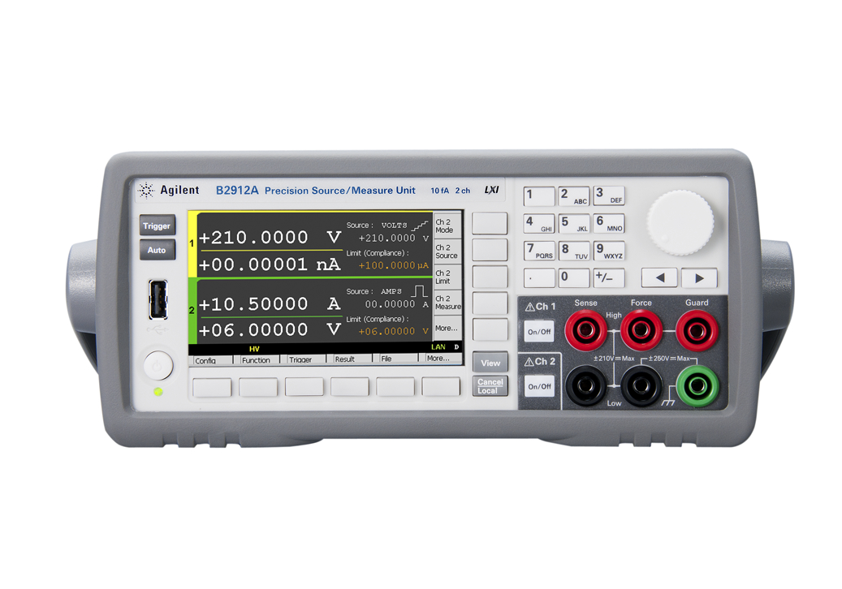
LXI Is Ready With LXI IPv6 Standard
Munich, 22 June, 2012—LXI adopts LXI IPv6 Standard
Specifies how LXI Instruments support IPv6
First LXI instrument passes LXI IPv6 Conformance Test

Slide 4
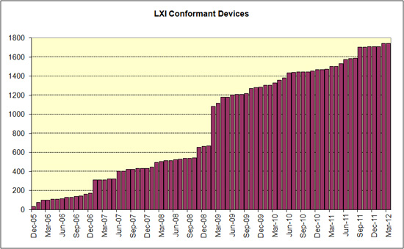
LXI: Standards+Testing for LAN Behavior
LXI 1.0 1.1 1.2 1.3 1.4
(1588-2) (mDNS) HiSLIP
Trigger Bus
IPv6

Slide 5
LXI IPv6 Goals
Enable instrument control via IPv6
Instrument Web Pages over IPv6
Auto-generated, stable instrument IPv6 addresses
Aid the use of IPv6 addresses for instrument interaction
Support intermingling IPv4-connected and IPv6-connected instruments
Maintain IPv4 compatibility.
Instrument Control via IPv4
Instrument Web Pages via IPv4

Slide 6
IPv6 Promise and Problems
Promise
Stable, always-available, link-local IPv6 addresses
Auto-configured global IPv6 addresses via SLAAC (Stateless Address Autoconfiguration) or DHCPv6
LXI IPv6 requires both forms of addresses
Problems
IPv6 addresses: long and hard to remember
LXI requires IPv6 addresses on LXI web page, in LXI Identification XML, and in mDNS service announcements.
Temporary global IPv6 addresses change periodically
LXI requires instruments avoid such addresses by default.
Uneven IPv6 support by OS, network hardware, and ISPs
LXI sticks with most useful IPv6 core capabilities.

Slide 7
IPv6 Practicalities
LXI IPv6 requires Instruments accept IPv6 connect requests.
However, IPv6 connections require coordinated IPv6 support
Operating System, Firewalls, Routers, Corporate LAN infrastructure, Internet Service Providers
IPv6 support is getting better
Firewalls and Corporate LANs don’t block IPv6 by default
PC operating systems support IPv6 better (Dual stack IPv4/IPv6)
Routers supporting IPv6 are becoming more common
ISP support for IPv6 increasing

Slide 8
LXI: IPv4 and IPv6 Together
LXI IPv4 instrument connections behind switches will remain common.
IPv6 more important for new global address use or because of organizational standards.
IPv4/IPv6 dual stack technology allows intermingling IPv4 and IPv6 devices.
LXI continues to support IPv4.
LXI ready when IPv6 is needed.

Slide 9
Backup Slides

Slide 10
LXI: Standards + Testing for LAN Behavior
September 2005: LXI 1.0 standard.
August 2006: LXI 1.1 clarifies LXI Class A, B, and C device classes.
October 2007: LXI 1.2 standard, updates to IEEE 1588-2008 for precision clock, adds LXI Identification XML requirement.
October 2008: LXI 1.3 standard, requires mDNS-based zero config device and service name announcements.
May 2011: LXI 1.4 standard, changes to LXI Core and extended functions model.
May 2011: LXI Wired Trigger Bus specification update.
October 2011: LXI HiSLIP Extended Function adopted to support fast, instrument-like connections and IPv6 compatibility.
June 2012: LXI IPv6 Extended Function adopted to support instrument control and web access over IPv6.

